Slide 1


Analyzing Jobs Data for understanding the Future of Work
DATA225 Group 2 Project
Bhavana Prasad Kote (016044899) Fall 2022 MS in Data Analytics San Jose State University | Maharsh Soni ((016656770​​) Fall 2022 MS in Data Analytics San Jose State University
Sachin Kumar Srinivasa Murthy (016594773) Fall 2022 MS in Data Analytics San Jose State University | Rashmi Shree Veeraiah (016099395) Fall 2022 MS in Data Analytics San Jose State University

Slide 2

Motivation
There is no information on the dynamic shifts in the job markets w.r.t:
Skill demand
Employee perception
Prior literature on the future of work Skill Requirements across Firms and Labor Markets: Evidence from Job Postings for Professionals (harvard.edu) calls for a new information system design that allows to study granular changes in the skill requirements with a better understanding of how heterogeneity in skill demands translates to firm production technology.

Slide 3





Technology Stack
Database- Neo4j Aura DB
Data Warehouse- Redshift
ETL Tools- PySpark, Glue
Storage- AWS S3
Programming- Python, SQL

Slide 4
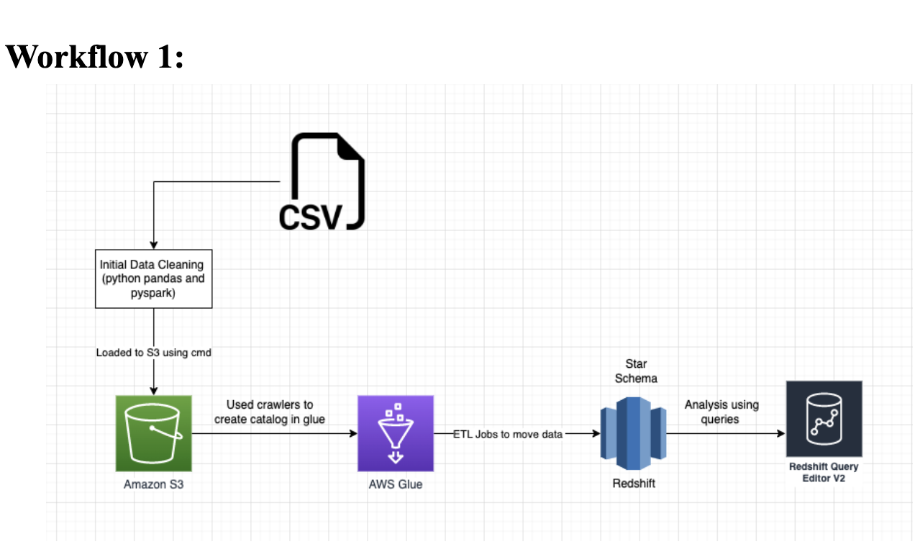
Workflow1

Slide 5
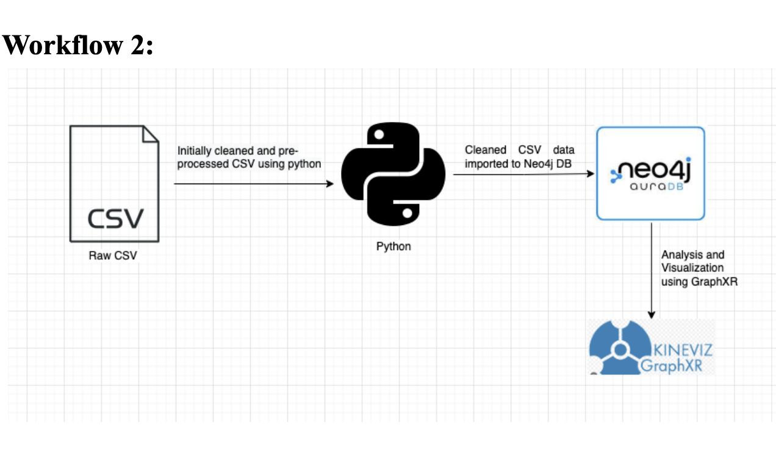
Workflow2

Slide 6
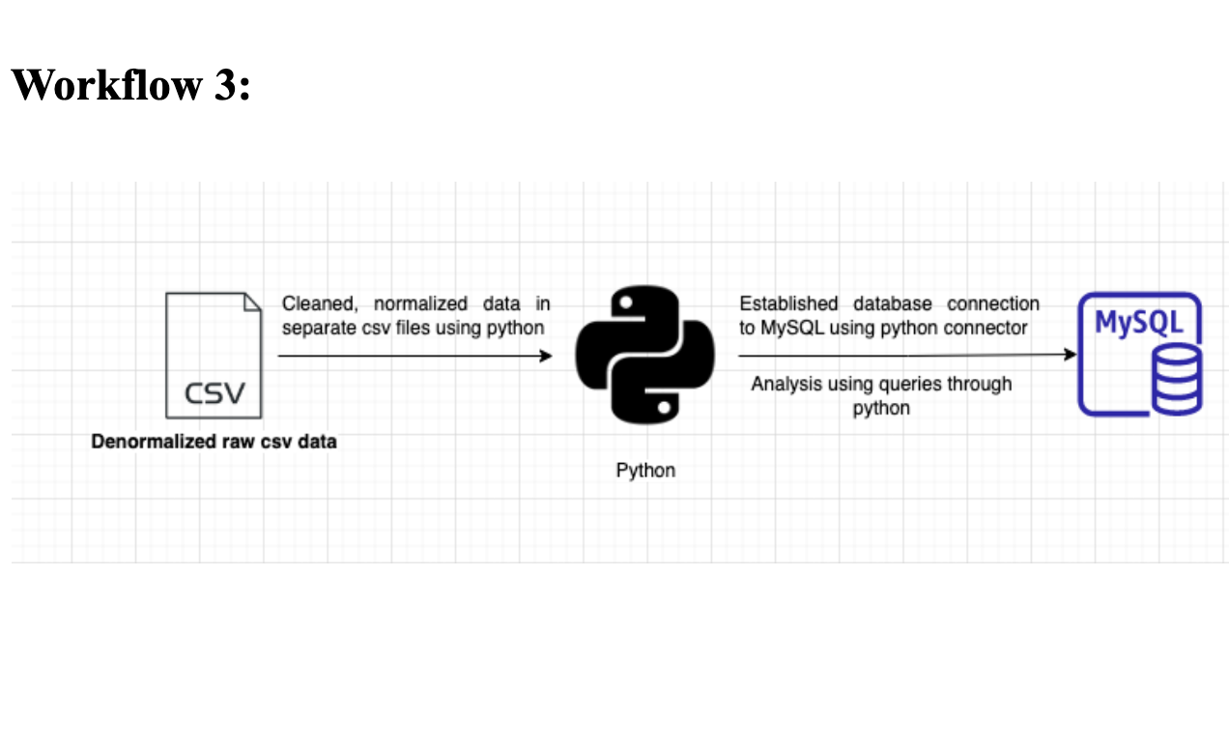
Workflow3

Slide 7
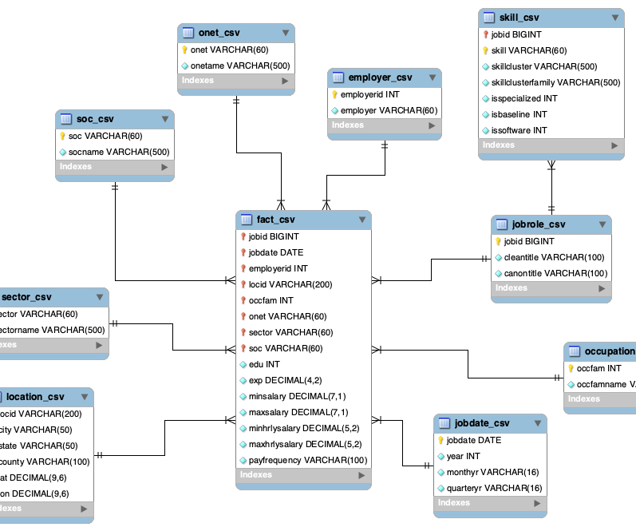
DATA MODEL-1
STAR SCHEMA

Slide 8
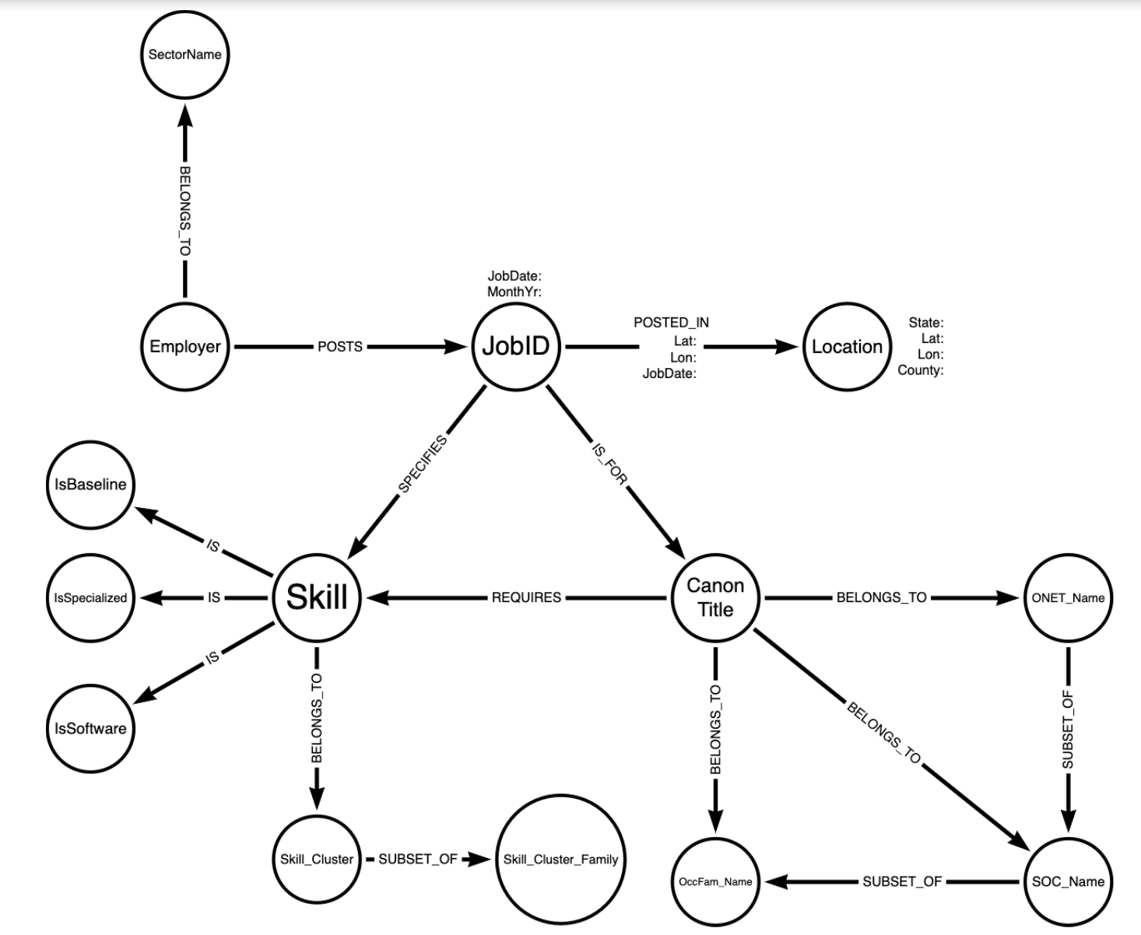
DATA MODEL-2
NEO4J DATA MODEL

Slide 9

RESULTS FROM NEO4J

Slide 10
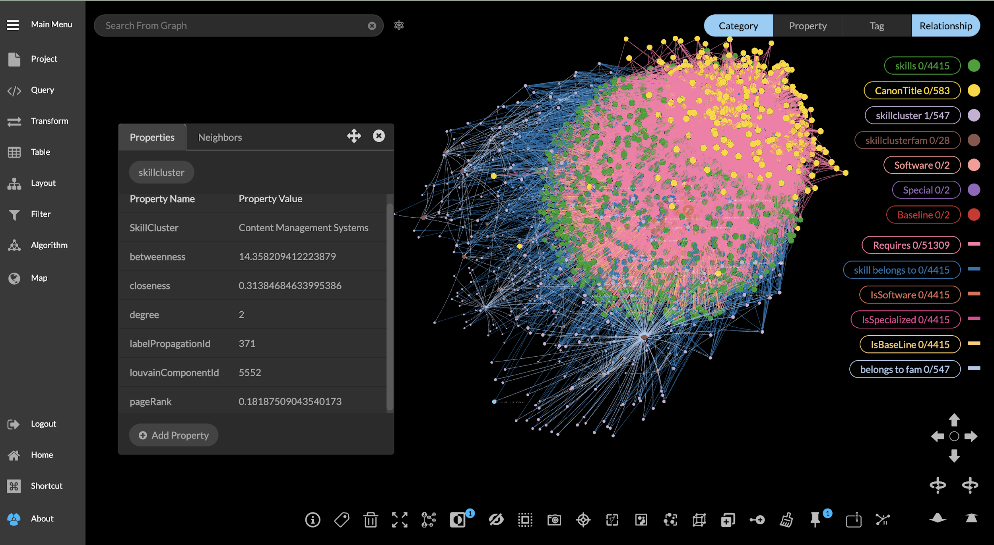
Results- Shift in skill demand over time

Slide 11
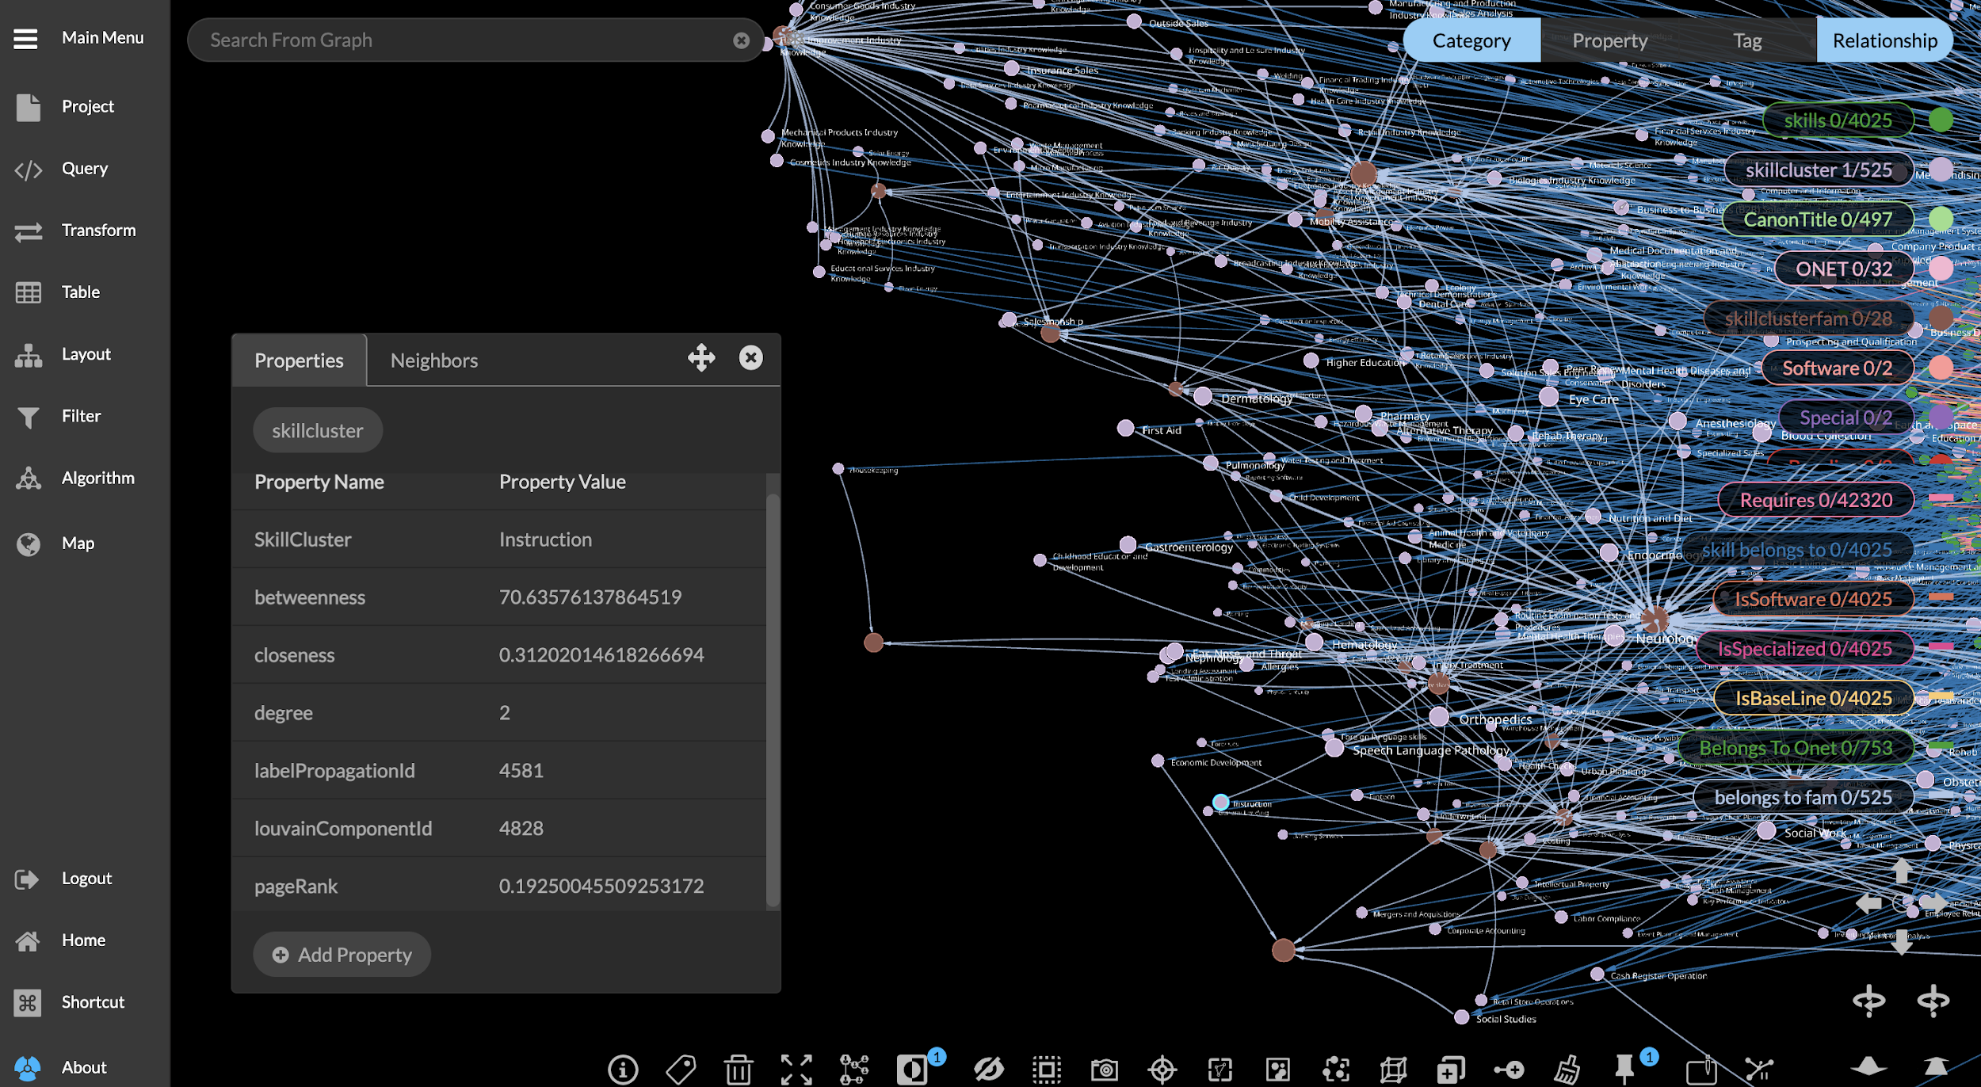
Results- Shift in skill demand over time

Slide 12
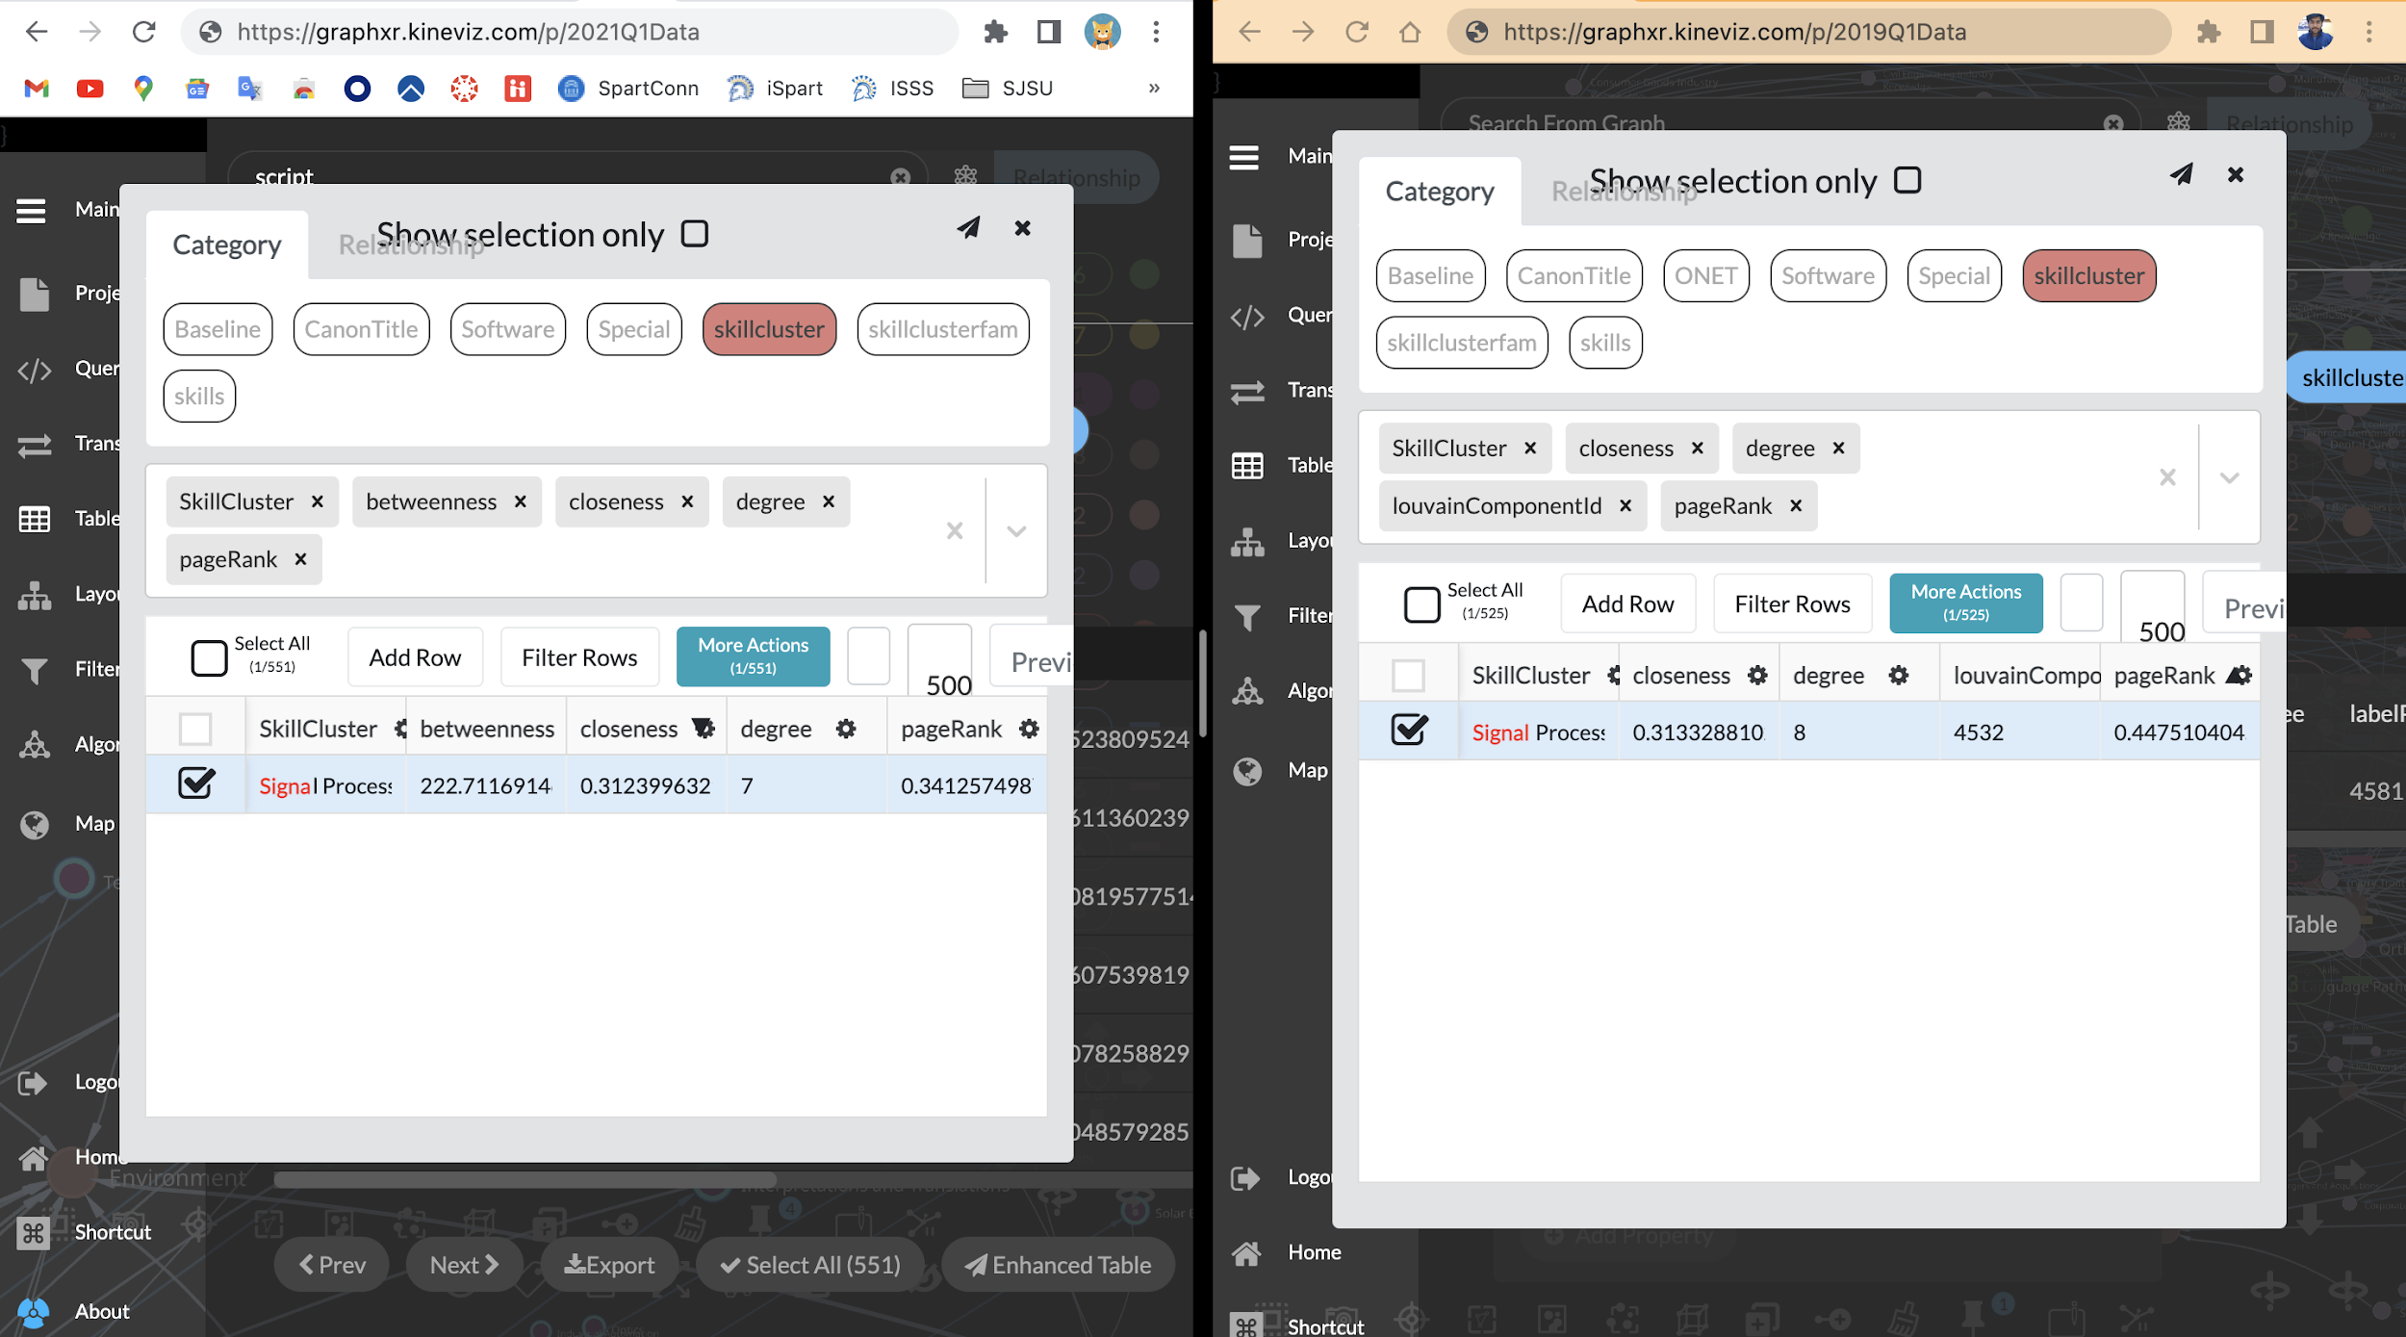
Results- Shift in skill demand over time

Slide 13
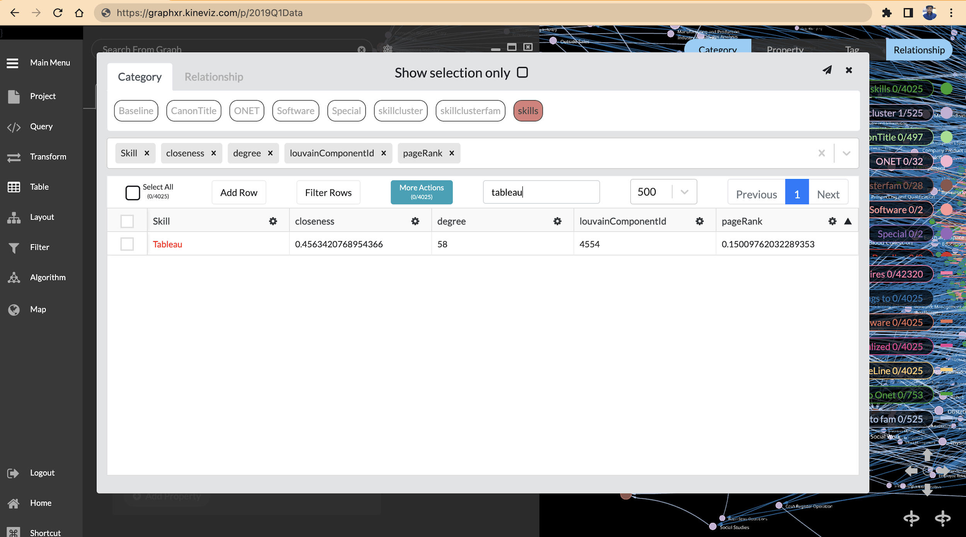
2019 demand for tableau

Slide 14
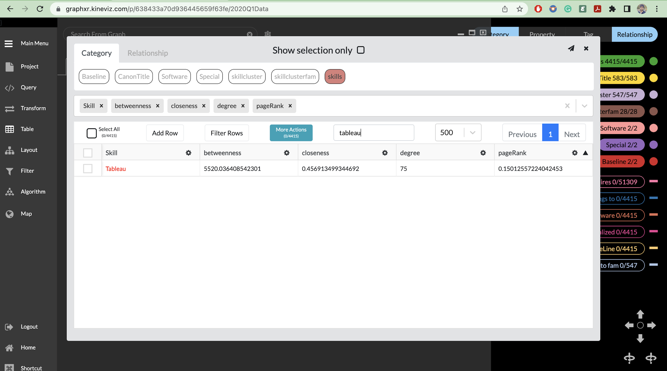
2020 demand for tableau

Slide 15
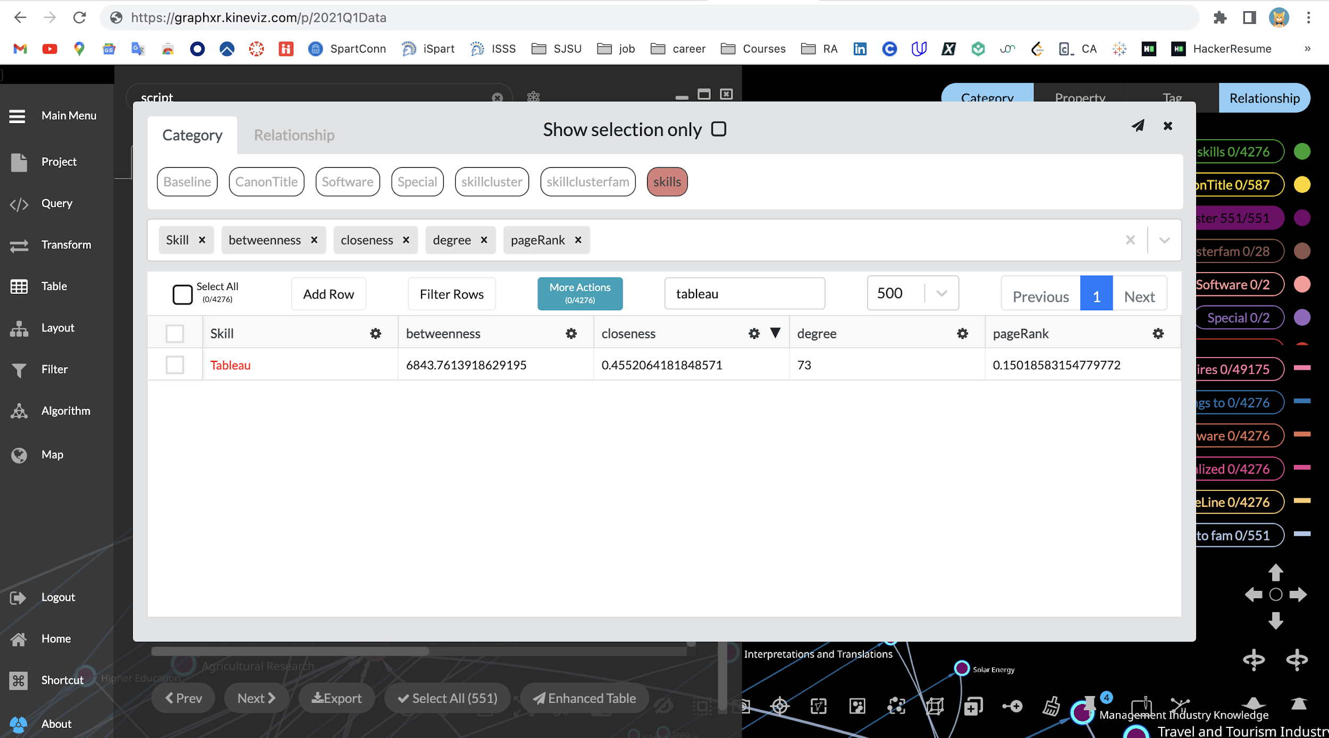
2021 Demand for tableau

Slide 16
Sample Results from Redshift Queries

Slide 17
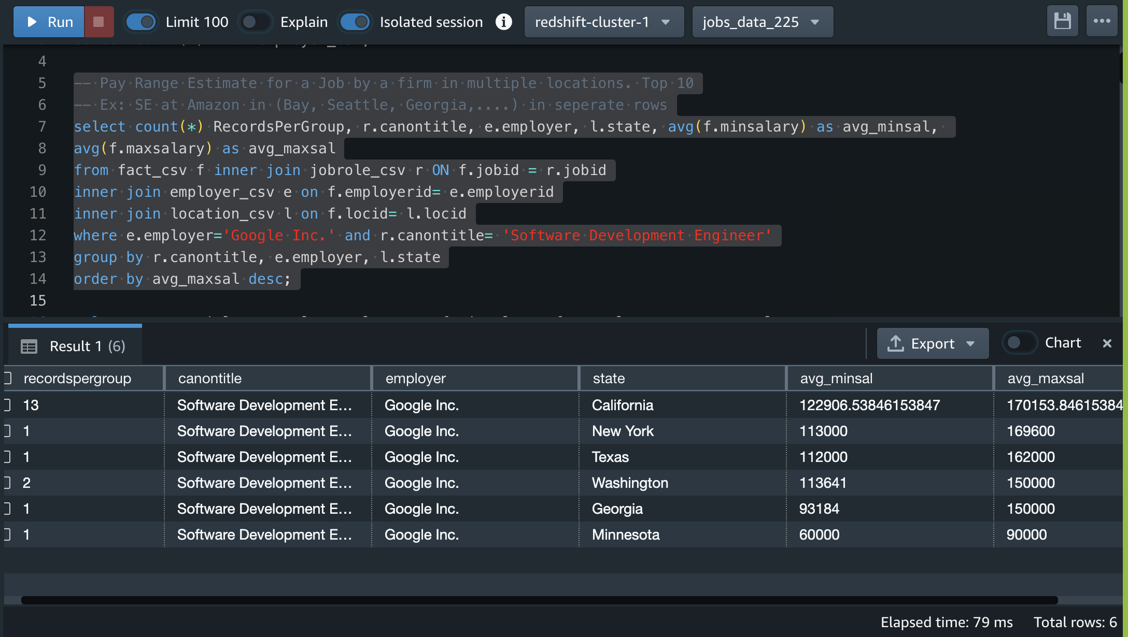
Salaries by firm, and role across states

Slide 18
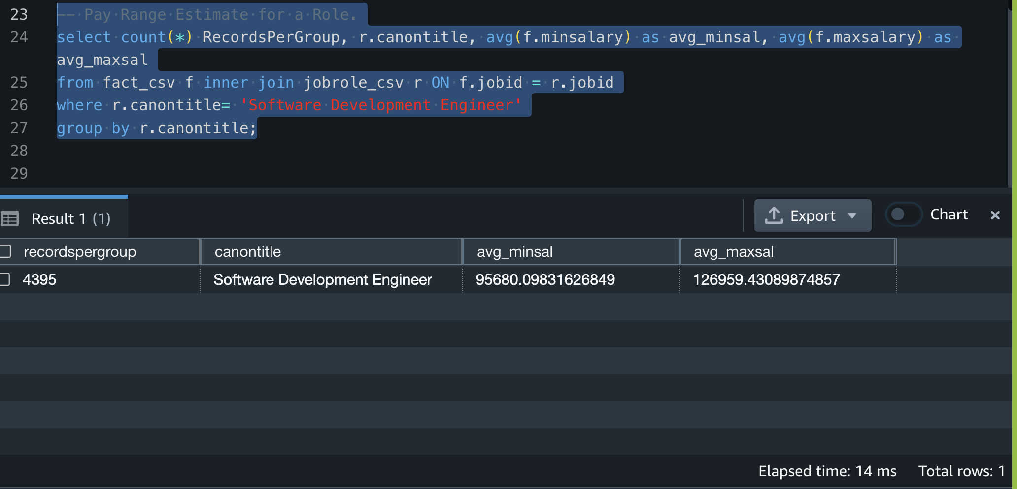
Pay Range Estimate for a role

Slide 19
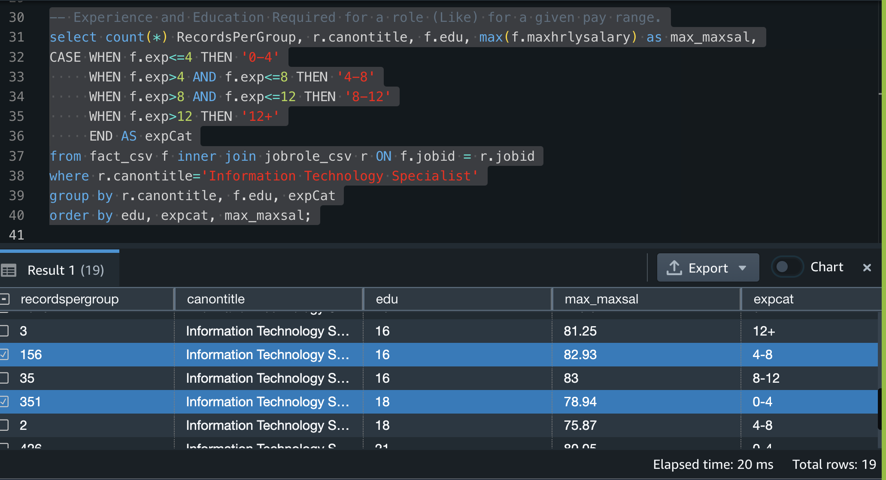
Experience and Education influencing payscale

Slide 20
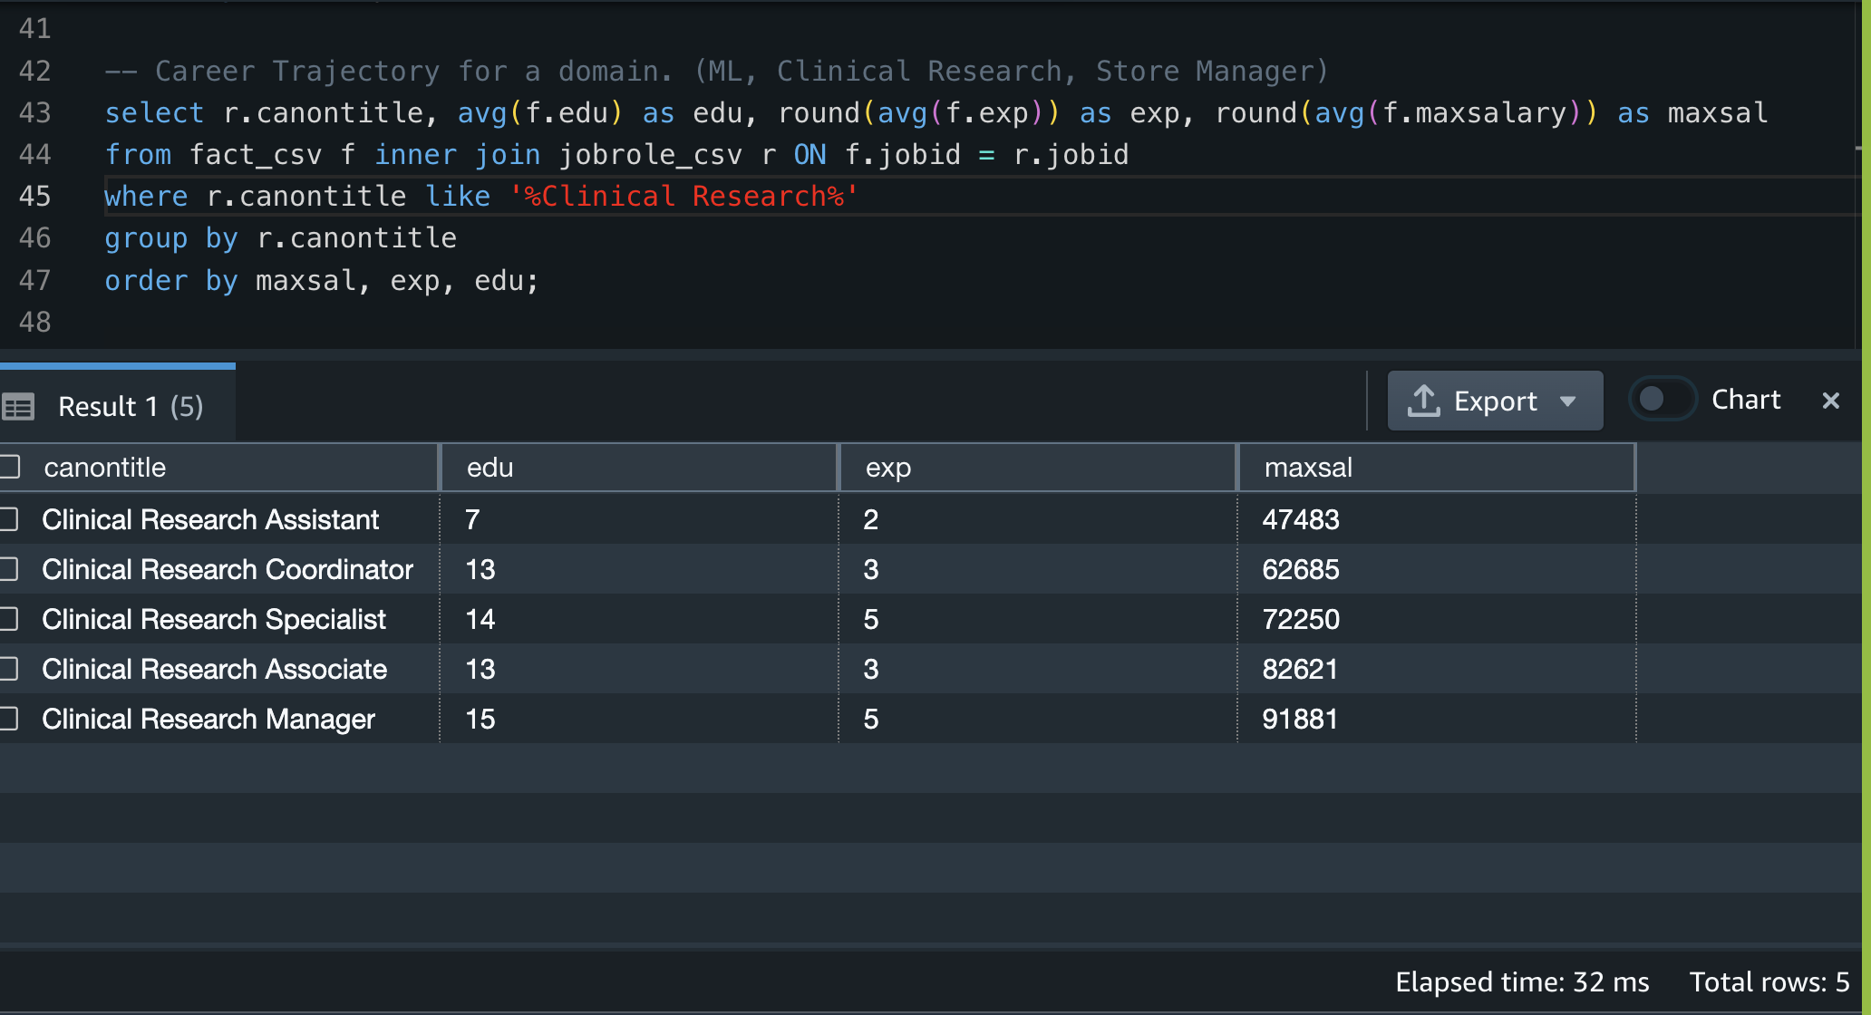
Career Trajectory

Slide 21
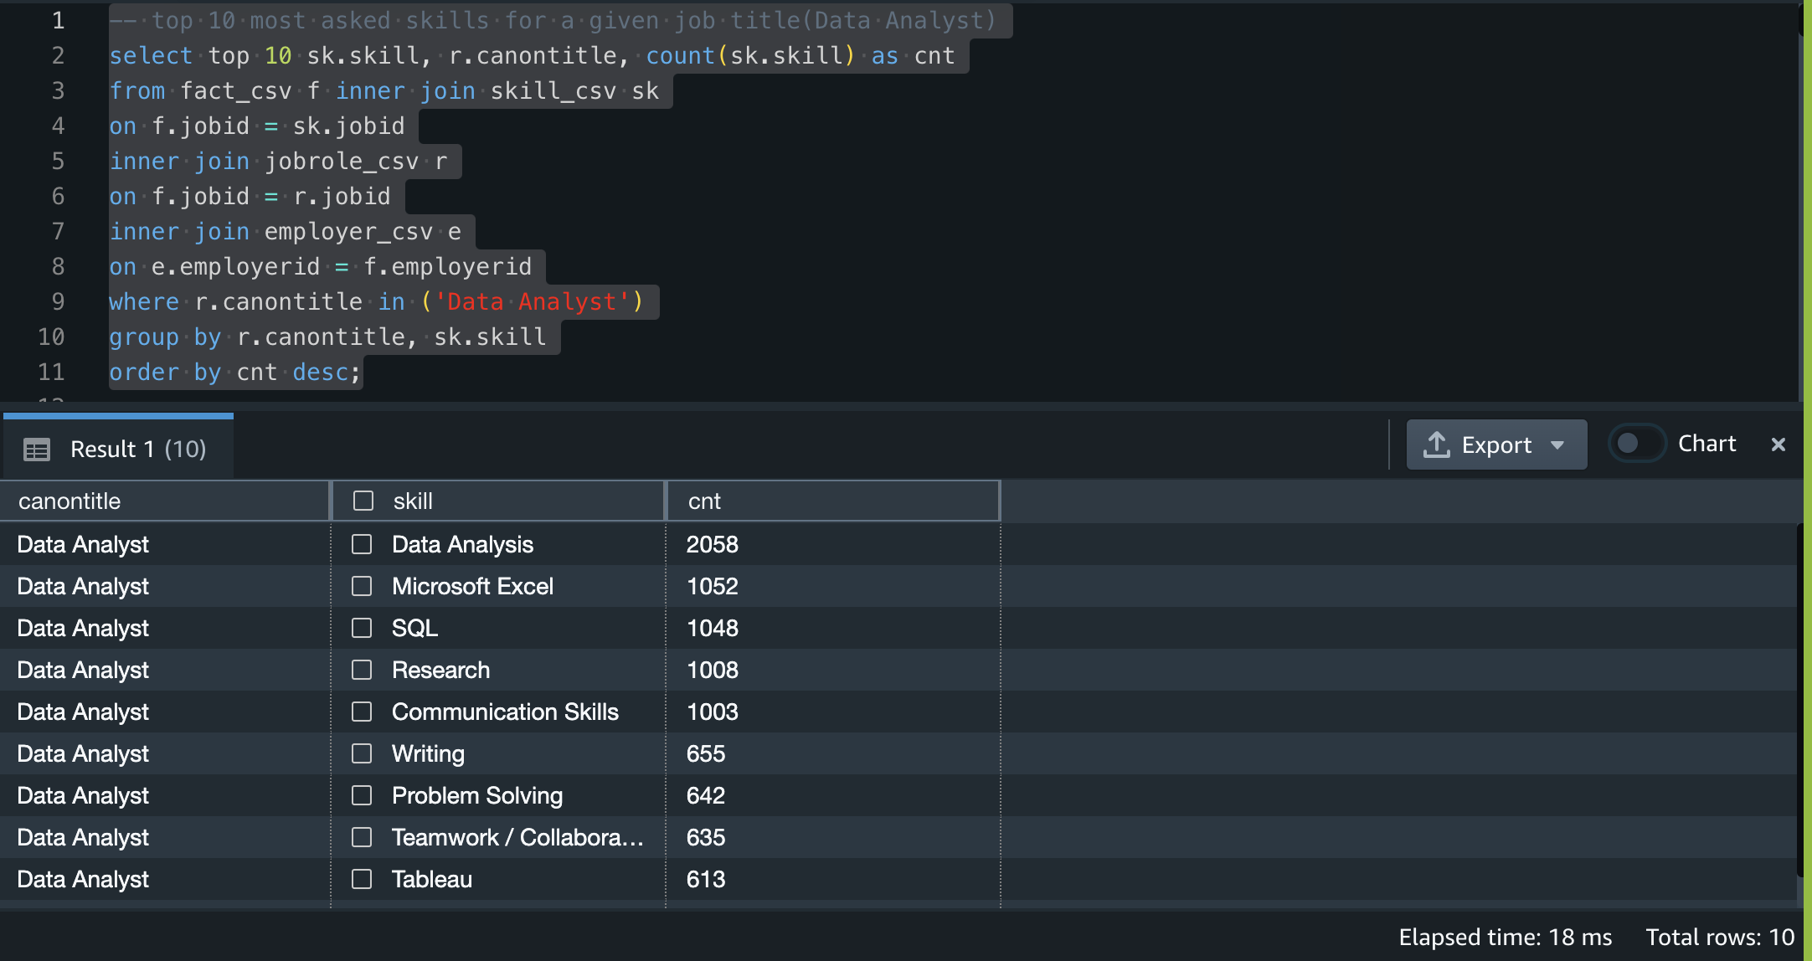
Top 10 required skills for Data Analyst

Slide 22
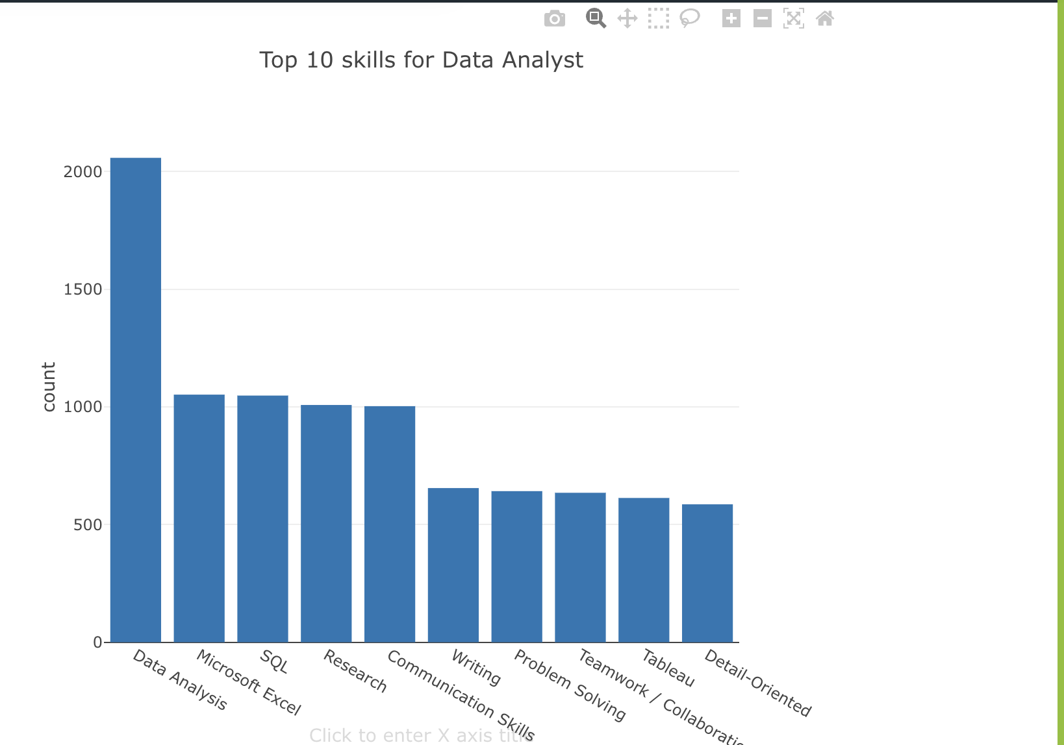
Top 10 required skills for Data Analyst

Slide 23
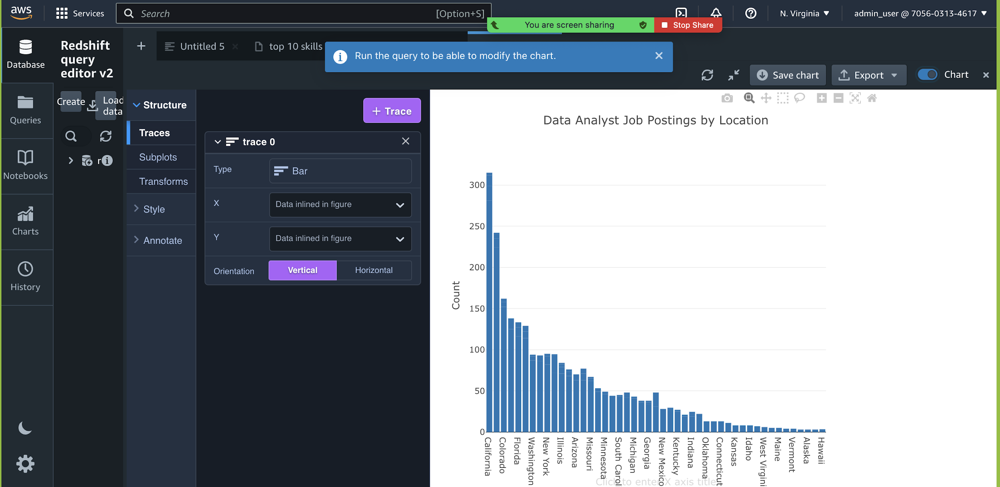
Job Postings for Data Analyst across states

Slide 24





Key Learnings
We learned how to use PySpark to deal with datasets of size 100GB+ with just an 8 GB RAM Machine.
We understand how the Spark Backend works, and processes data in RDDs
We learned the concepts of Graph Databases so much so that we were able to apply it and extend the work of renowned Harvard and Yale Data Scientists/ Applied Economists.
We learned how to use AWS Solution Stack to build end-to-end Data Engineering/ Data Warehousing Solutions.
We were able to understand the query design behind the scenes that give us results on job sites.

Slide 25
Technical Difficulties
Due to the Neo4J Aura DB’s limitations with the free tier, we were unable to use all the data in our Neo4J Data Model. We struggled a bit to come up with an ideal way of handling this, and this took incredible amount of time.
The Learning curve with the AWS Solution Stack was challenging, we had very little time to explore the tools to its fullest capabilities.
The Technical difficulty with reducing the size of the dataset from 100 million jobs to 1 million Jobs was demanding. Learning pyspark ahead of time helped us tackle this difficulty. This ETL script is the biggest piece of code file in our project.

Slide 26
Conclusion
We have successfully built a new information system design that can inform the shift in demand for skills, and skill Clusters overtime.
Our solution is built using limited datapoints due to the free tier limitations. However, our solution can be extended with the entire length of the data set and it would still work flawlessly.
We have also built queries that mimic the behind the scenes functionalities of the job sites to reterive useful information. We used a Data Warehousing solution to build this query functionality.

Slide 27



Future Work
We believe that our information system design can be extended with the employee reviews data to inform on the shift in employee perceptions over time by industry, sector, employer, location, etc… It is very important to understand the employee perceptions to track the health of economy and an industry over time.
With funding/ access to unlimited use of Neo4j Aura DB, we can use our full dataset of 100 Million Job Postings to show the true shift in demand for skills over time.
We also would like to propose the implementation of this solution to better inform the workforce on what skills to focus on to land better job opportunities. Right now, the only source of learning which tools to learn is from stack overflow developer survey. However, Job Postings are more accurate than the survey, and job portals must bring in a change and incorporate more informative solutions like the one we prosposed in this project.

Slide 28

Thank you! Any questions?

Slide 29

DEMO

